Slide 1
Prologue A look at an HDF file

Slide 2
Sample file

Slide 3
Part 1 How HDF came about, and why

Slide 4

The early years

Slide 5
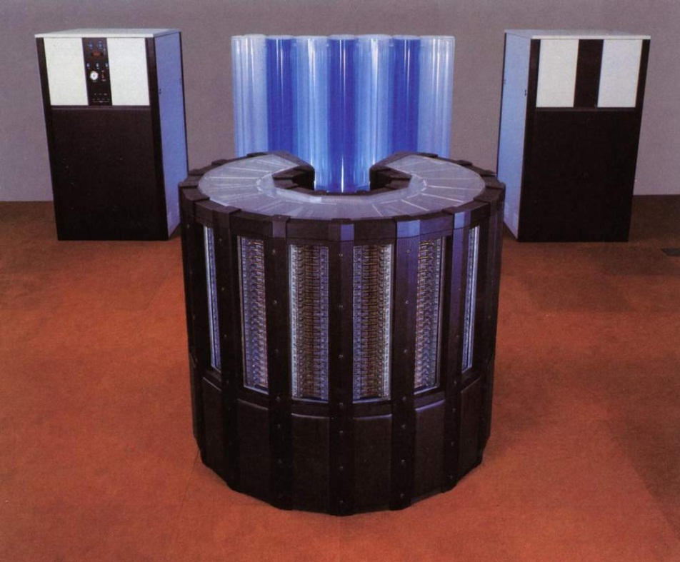
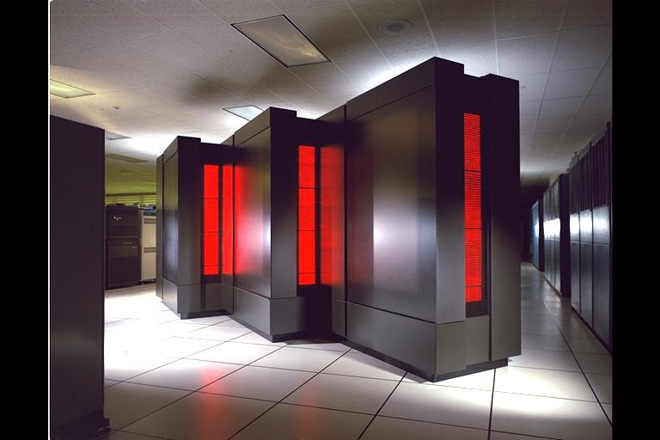
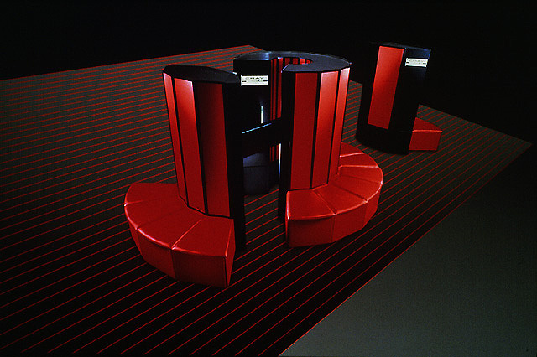
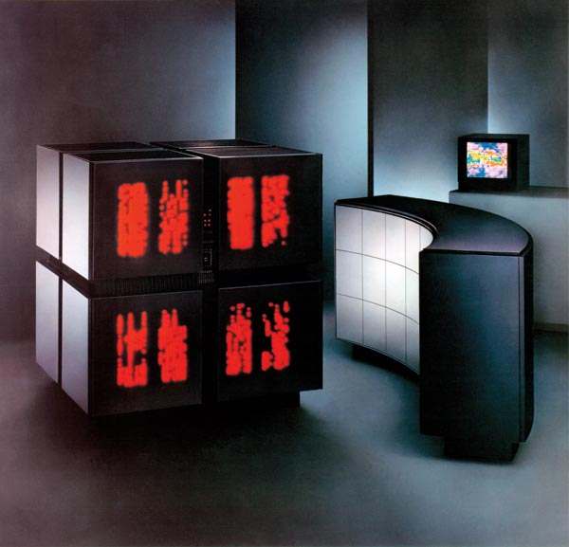

Slide 6
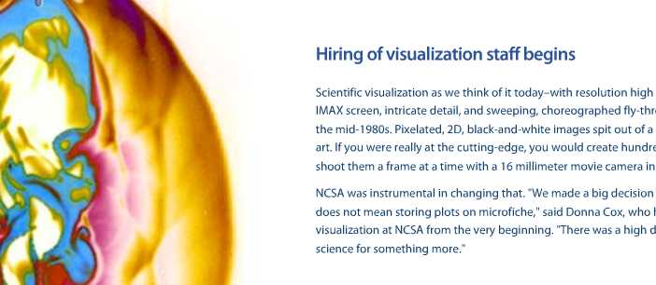
NCSA 1986

Slide 7
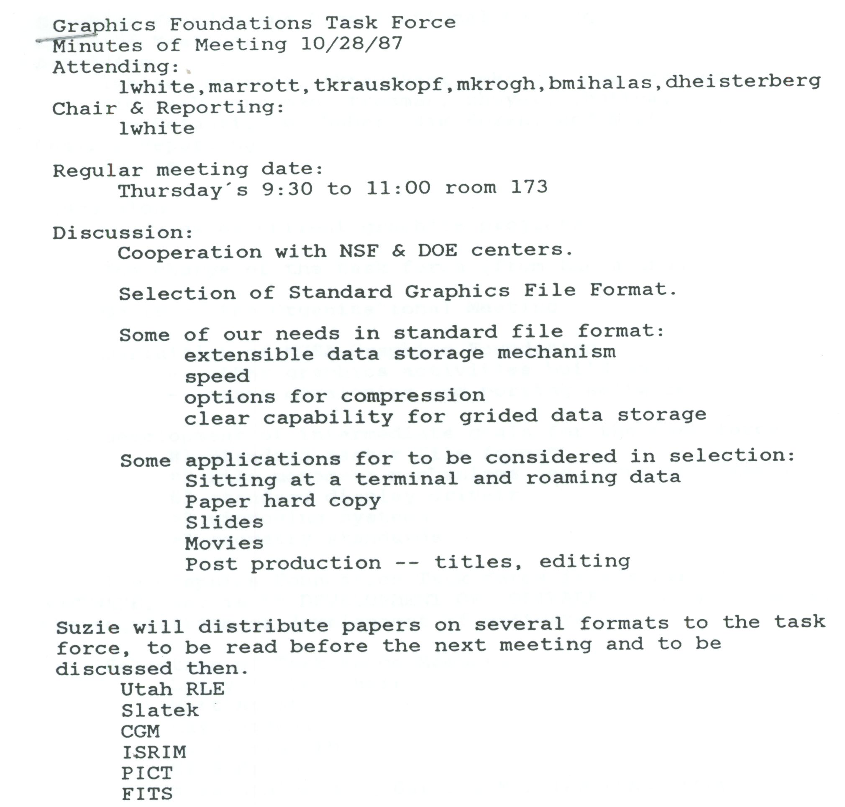
GFTF Oct 28, 1987

Slide 8
GFTF Oct 28, 1987

Slide 9
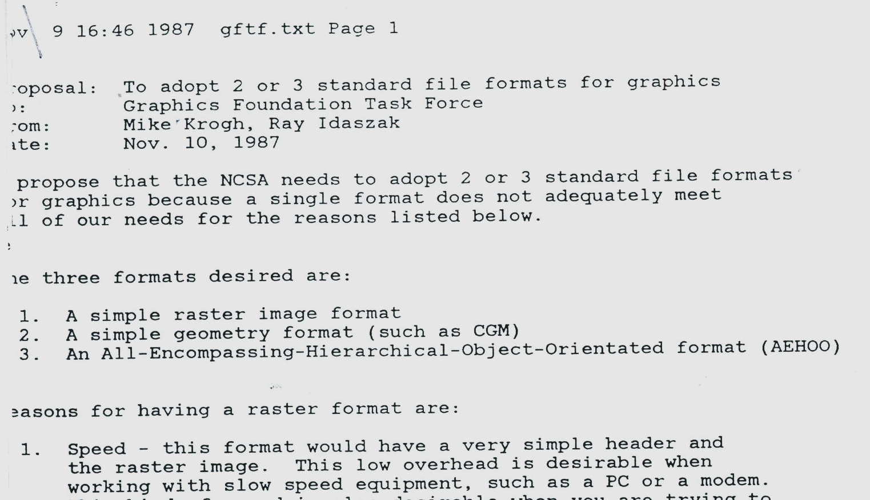
GFTF Nov 9, 1987

Slide 10
GFTF Nov 9, 1987

Slide 11
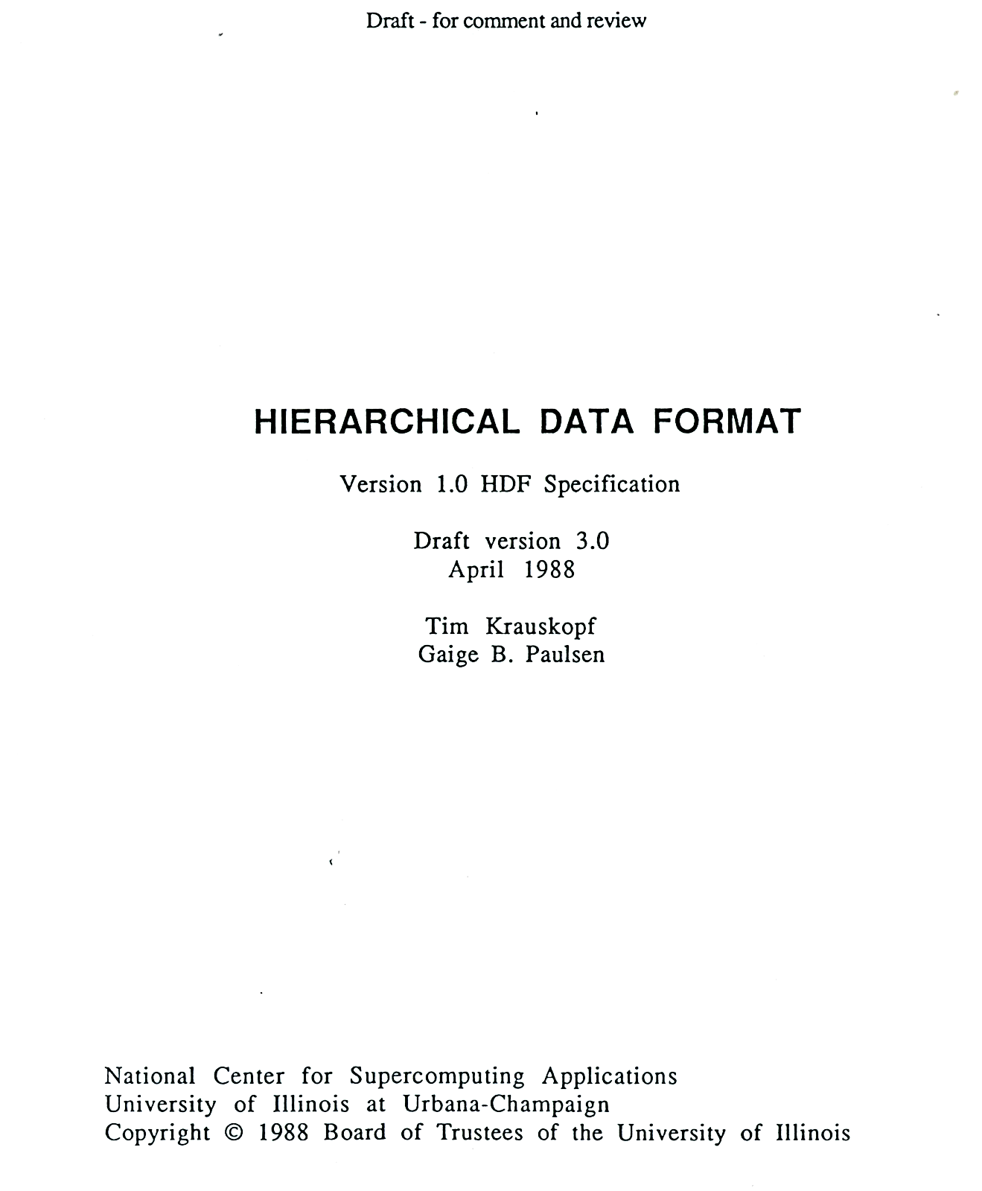

Slide 12
Library
Version 1 – 1988
Primitive objects
“raster,” “palette”, “aspect ratio”
“sets” or groupings to form higher level objects
“raster image set”
Version 2 – 1989
Scientific data sets
24-bit raster

Slide 13
Library
Version 3 – 1990
Subsetting
Vertex sets (Vsets)
Groups (Vgroups), and tables (Vdatas)
Version 4 – 1996
Full multiple file, multiple object access

Slide 14
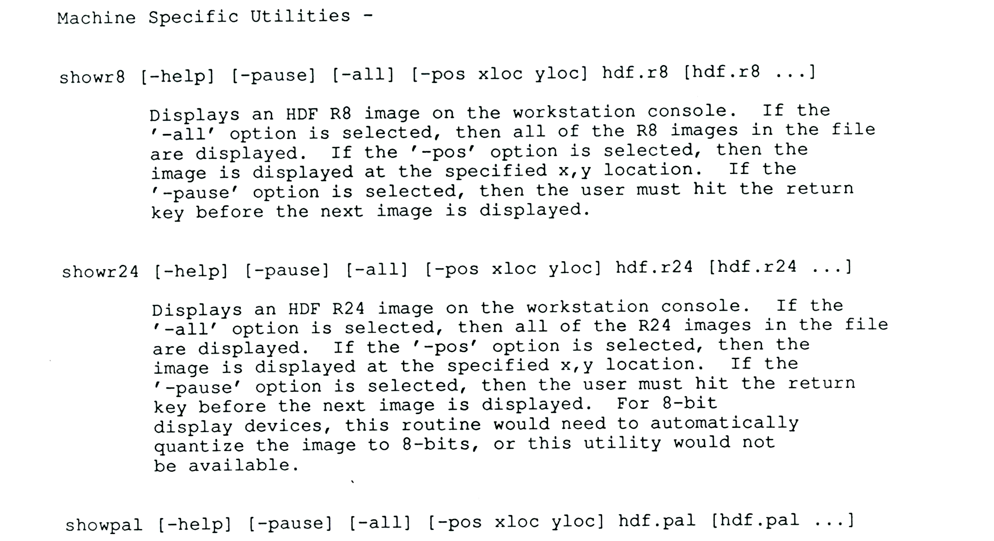
Command line tools

Slide 15
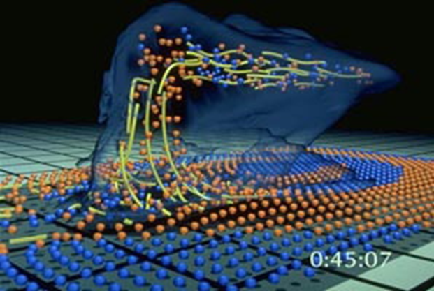
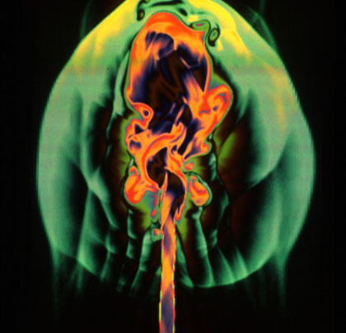
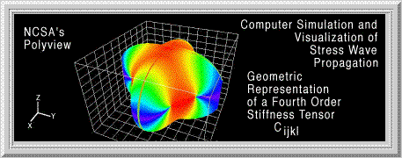
NCSA software
Big simulations with HDF
Desktop visualization with “NCSA Image”
Desktop visualization with PolyView
Notes:
Wilhelmson
Norman
Polyview: Kriz paper: http://www.sv.vt.edu/NCSA_WkShp/kriz/WkShp_kriz.html

Slide 16
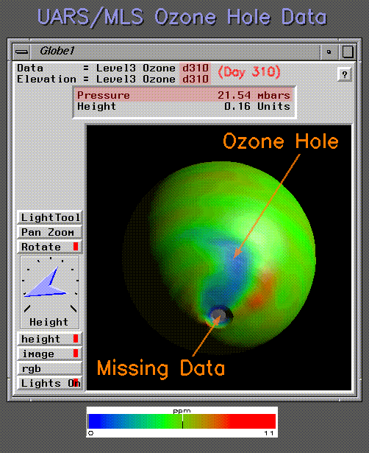


Slide 17
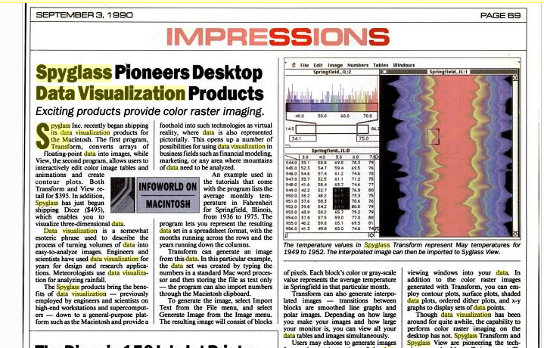

Slide 18
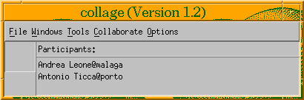
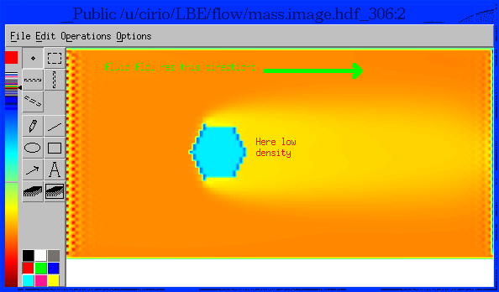

Slide 19
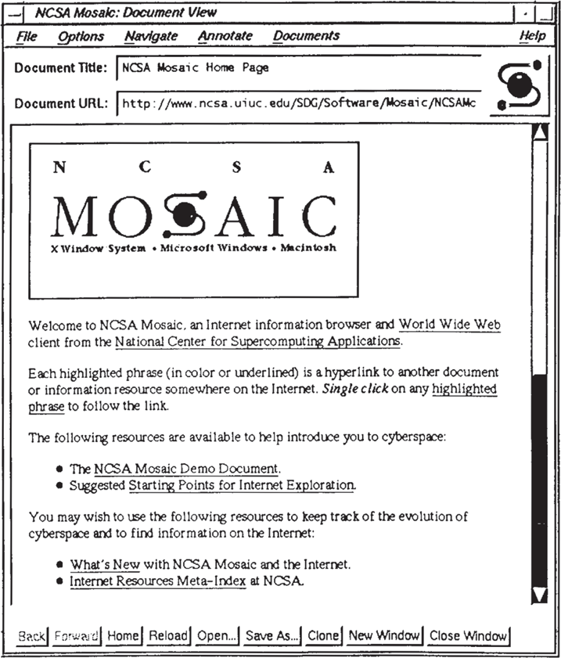
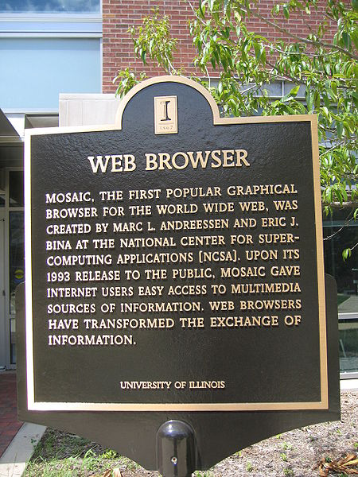

Slide 20
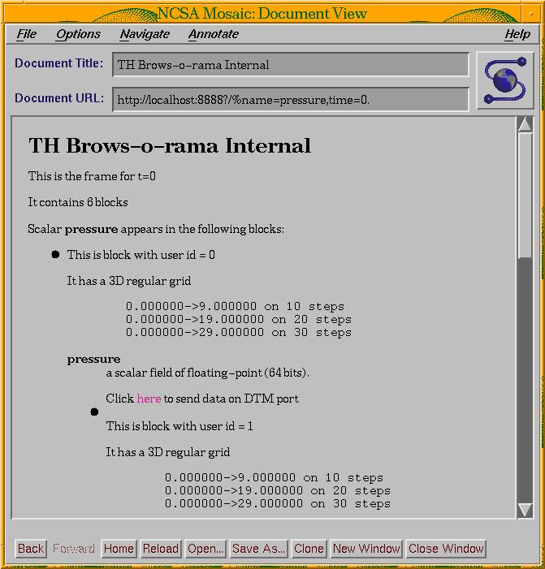
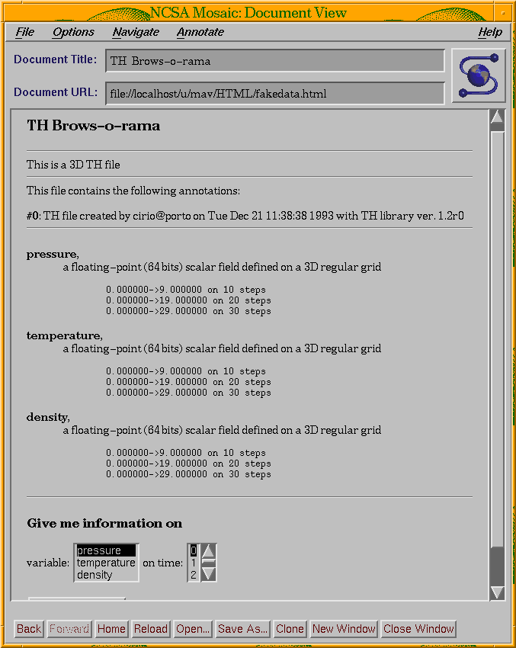

Slide 21


Slide 22


NetCDF Harmonization
NSF $ =
+

Slide 23
“NSF Software Capitalization”
User support
Documentation
testing
NSF $ =

Slide 24
Other adopters of hdf

Slide 25
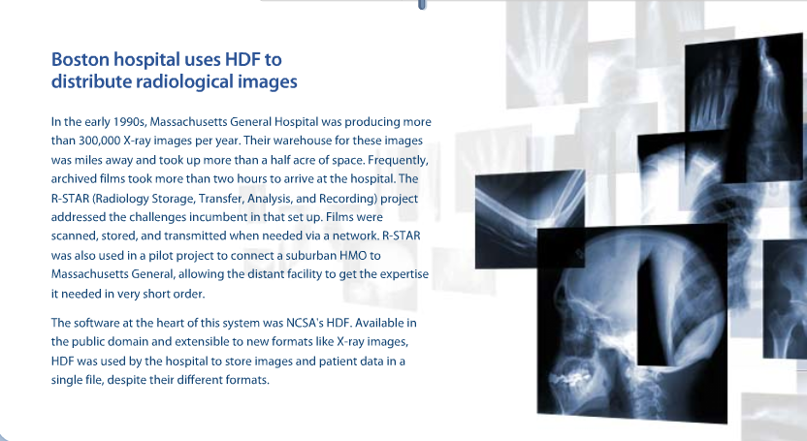
Other adopters of HDF

Slide 26

Other adopters of HDF

Slide 27
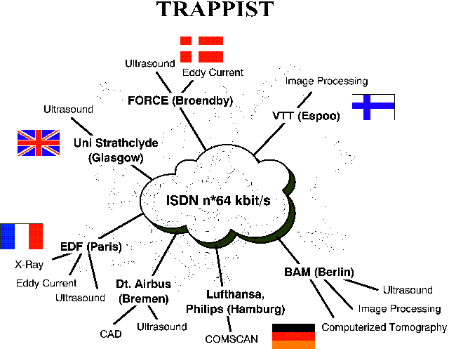
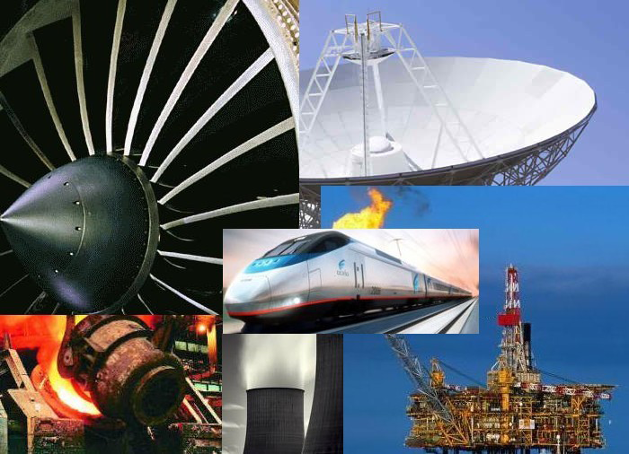
Other adopters of HDF
Non-destructive testing

Slide 28
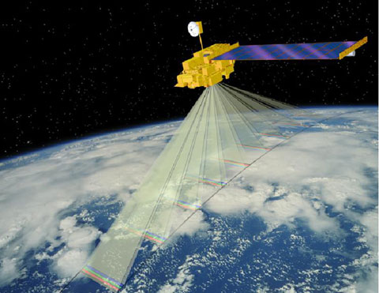
Earth Observing System
Notes:
The biggest development for HDF in the early 90s was NASA’s Earth observing system. (Next.)

Slide 29

Earth Science (Earth Observing System)
Terra
CERES MISR MODIS MOPITT
Aqua (6/01)
Aqua CERES MODIS AMSR
Aura
TES HRDLS
MLS OMI
Notes:
EOS has 3 primary satellites, each with several instruments, and a number of other satellites.
Interoperability daunting.
Volume, complexity.
15 tried, HDF chosen.
NSF role significant
Software capitalization provided the quality and support needed to make HDF a candidate for mission-critical operations.
NetCDF harmonization key to interoperability

Slide 30
Message: HDF needs to support mission critical applications with high quality and performance standards

Slide 31
A need for change?
Shortcomings of HDF (1996)
Limits on object & file size (<2GB)
Limited number of objects (<20K)
Rigid data models
I/O performance
Code complexity

Slide 32
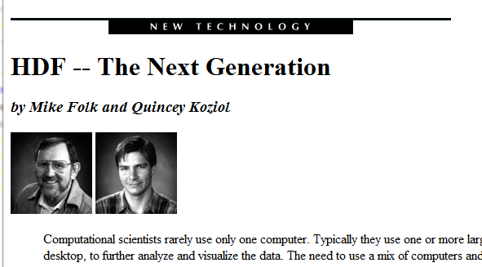
NCSA Access, Spring 1996
Notes:
Spent some time trying to figure out how to evolve HDF to address these shortcomings.
Ultimately decided, better to start over.

Slide 33
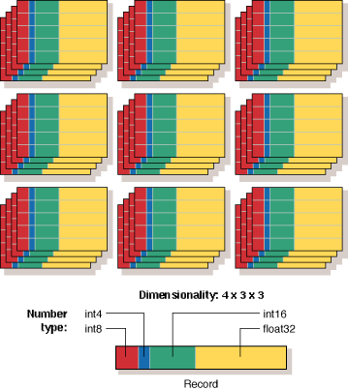
Notes:
One way of addressing issues of code complexity and rigid data models, was to avoid creating a number of different objects such as raster images and sets tables and so forth.
Instead we decided the new version would have one basic structure, multidimensional array structure, where the elements of the array could be virtually any data type you could define.
This unified array structure, called a data set, combined with a rich collection of available data types, was very important to the success of the new version of the HDF format.

Slide 34
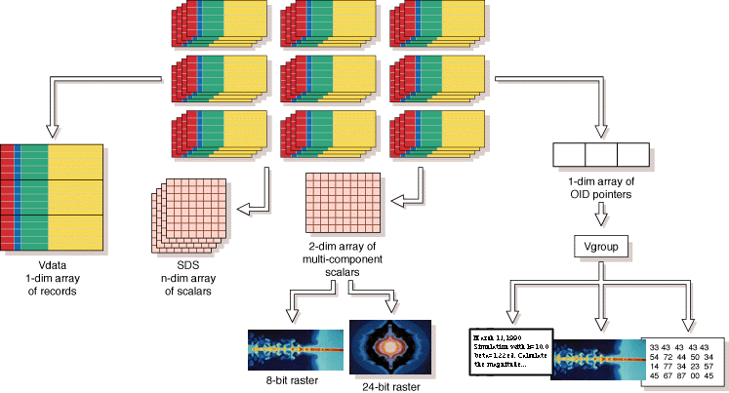
Notes:
With the new comprehensive structure, it’s possible to define all the structures used in the original HDF.
Here we see how the table structure, the scientific data set and the raster image structures all can be derived from this structure.
(next)

Slide 35
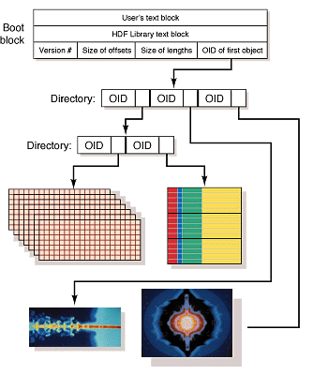
Notes:
We even had in mind originally that the grouping structure would be derived from this as well, as shown here.
Ultimately we decided against that, however, and created a separate grouping structure.
Shopped around this idea, but at first no takers. (Next)

Slide 36
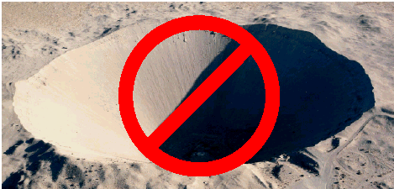
ASCI = Accelerated Strategic Computing Initiative
We Have A Nuclear Test Ban Treaty
How do we maintain a nuclear stockpile in the absence of testing?
Notes:
Then came ASCI.
Result of nuclear test ban treaty of 1992.
How maintain nuclear stockpile in absence of testing?
Answer: through very large scale simulations on much larger systems.

Slide 37
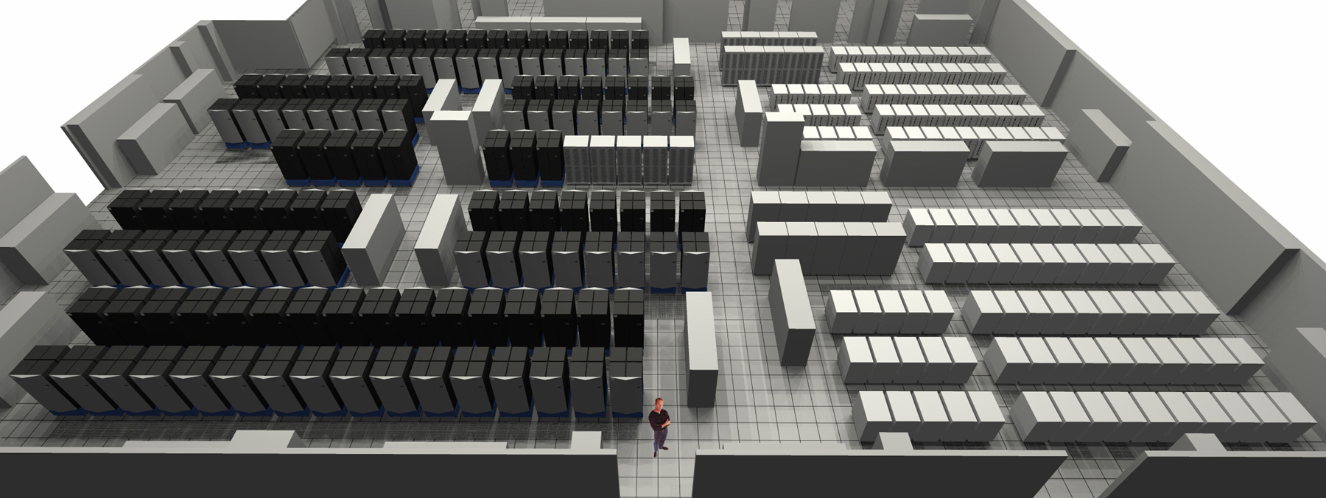
Notes:
Required new systems, orders of magnitude bigger and faster.
Systems would become available by end of decade in the three labs at Livermore, Sandia, and Los Alamos.

Slide 38
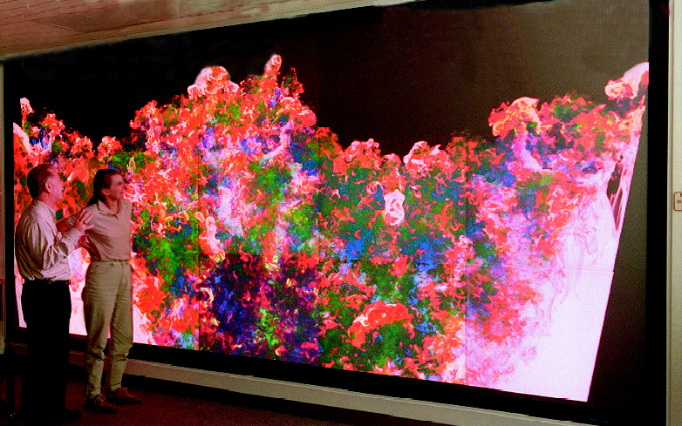
Big simulations
A simulation can have billions of elements
Each element can have dozens of associated values
Notes:
Applications would involve correspondingly several orders of magnitude more data.
Not just more, but new parallel architectures that would require new techniques for reading and writing data.

Slide 39





ASCI Data models and Formats Group
Notes:
DMF
Tri-lab collaboration

Slide 40
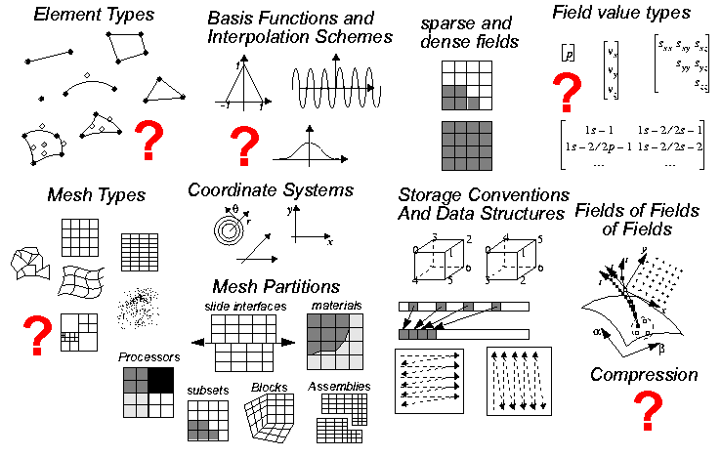
Describing data is challenging

Slide 42
HDF audience (1997)
Applications facing big data challenges
Academia, government, industry
Hundreds of different applications
Users world-wide

Slide 43

Something is missing
Notes:
As we see, the focus on scalable applications, complex data, data variety, parallel systems, and so forth.
Good, but there was an important missing part that many of us weren’t considering but that lay under the surface.

Slide 44
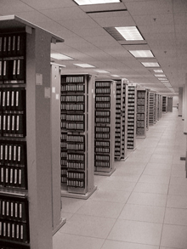

What is on these tapes?
?
Notes:
Al Fleig in 1990 took me to a hallway at NASA where there were racks upon racks of shelves containing old magnetic tapes. Al said to me, “Mike, do you see all of those tapes. Some of them are decades old. They contain priceless data that can help us understand our planet as a system. And Mike, guess what, we don’t have any way to get to the data on most of those tapes because we can’t find the information we need to decipher them. Is there some way with HDF that we can put information at the start of the file – a name, a phone number, anything – that would give us a fighting chance to figure out that information?”
That conversation with Al stuck in my mind from that day forward. When it came time to redesign HDF by creating HDF5, one of the things we did was introduce the use of a user block, so that someone could put their name, or anything else they wanted to, at the beginning of a file, so that the creator or someone else can provide information that will give posterity a fighting chance to figure out what’s in the file.

Slide 45
Message: Communities are committing critically important data to HDF for the long term, and expect it to last.

Slide 46
The middle years
Notes:
1998-2006
Probably the best way to describe the middle years is to say that the early years were ones of developing the basic technologies and beginning to see wide adoption of HDF, whereas the middle years saw important changes to how we, as a group, needed to work with a growing and changing user base.

Slide 47

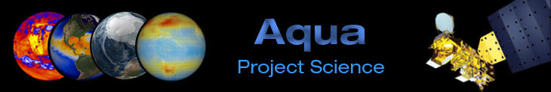
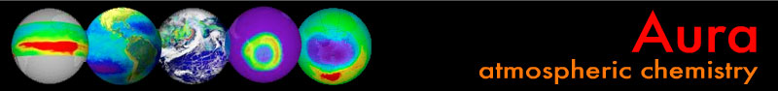

Slide 48
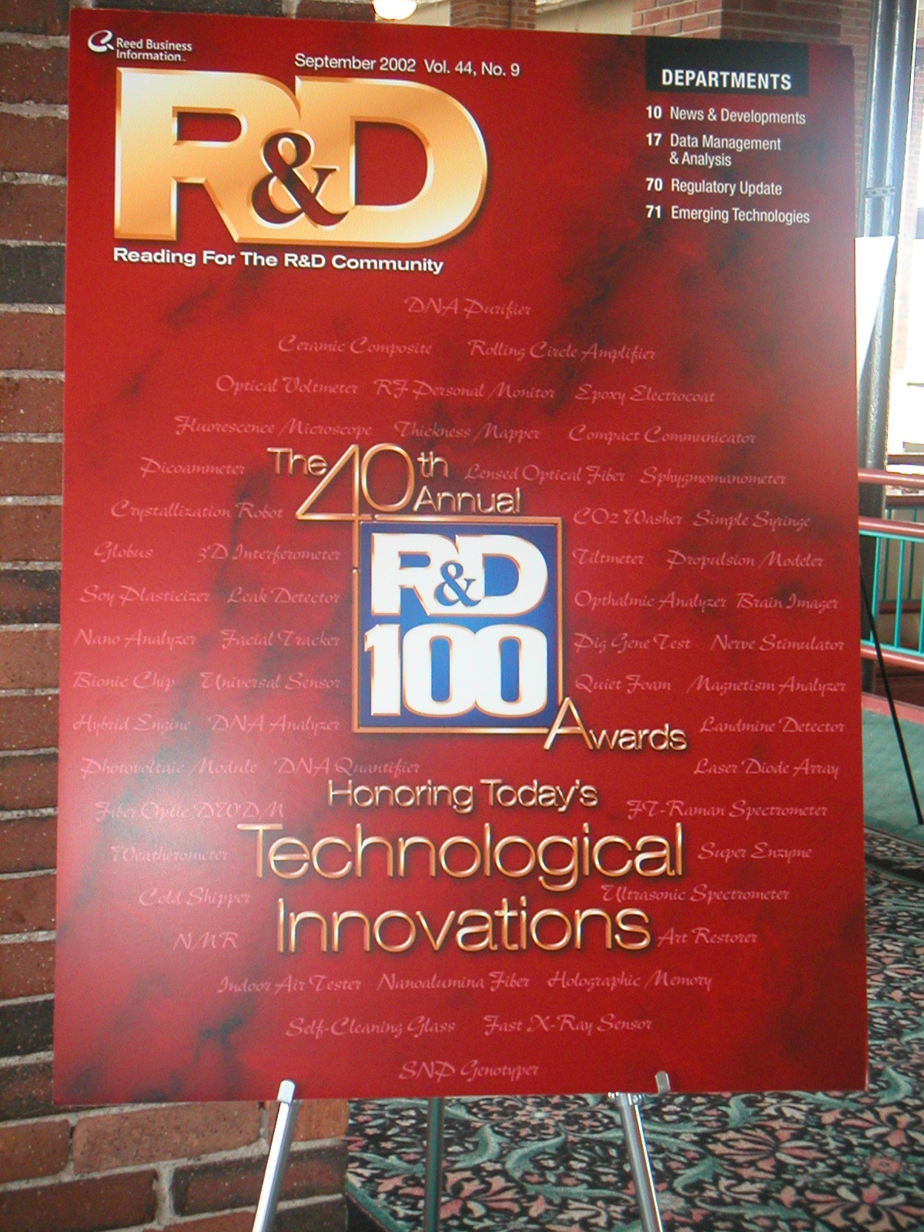
R&D 100
Notes:
We, LLNL, SNL, LANL were excited
100 most significant, newly introduced research and development advances

Slide 49

Changing user profile

Slide 50
Flight testing

Slide 51
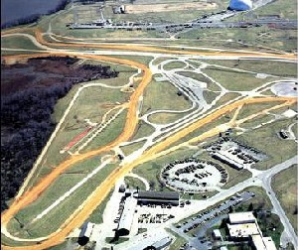
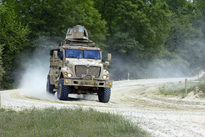
Vehicle testing

Slide 52
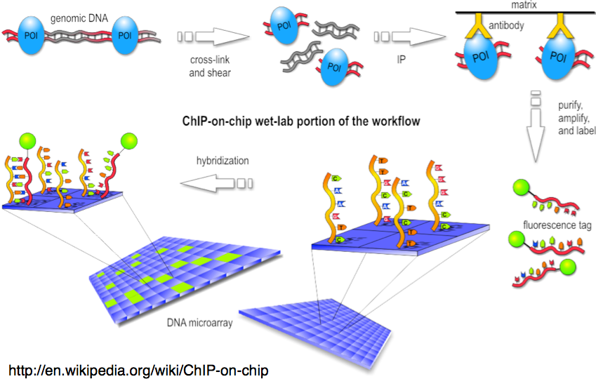
Bioinformatics
Notes:
Genomic data in particular
Good example of old technologies not being able to scale, so turn to HDF5.
Geospiza in 2004.
Since then new sequencing technologies have exacerbated the problem.

Slide 53
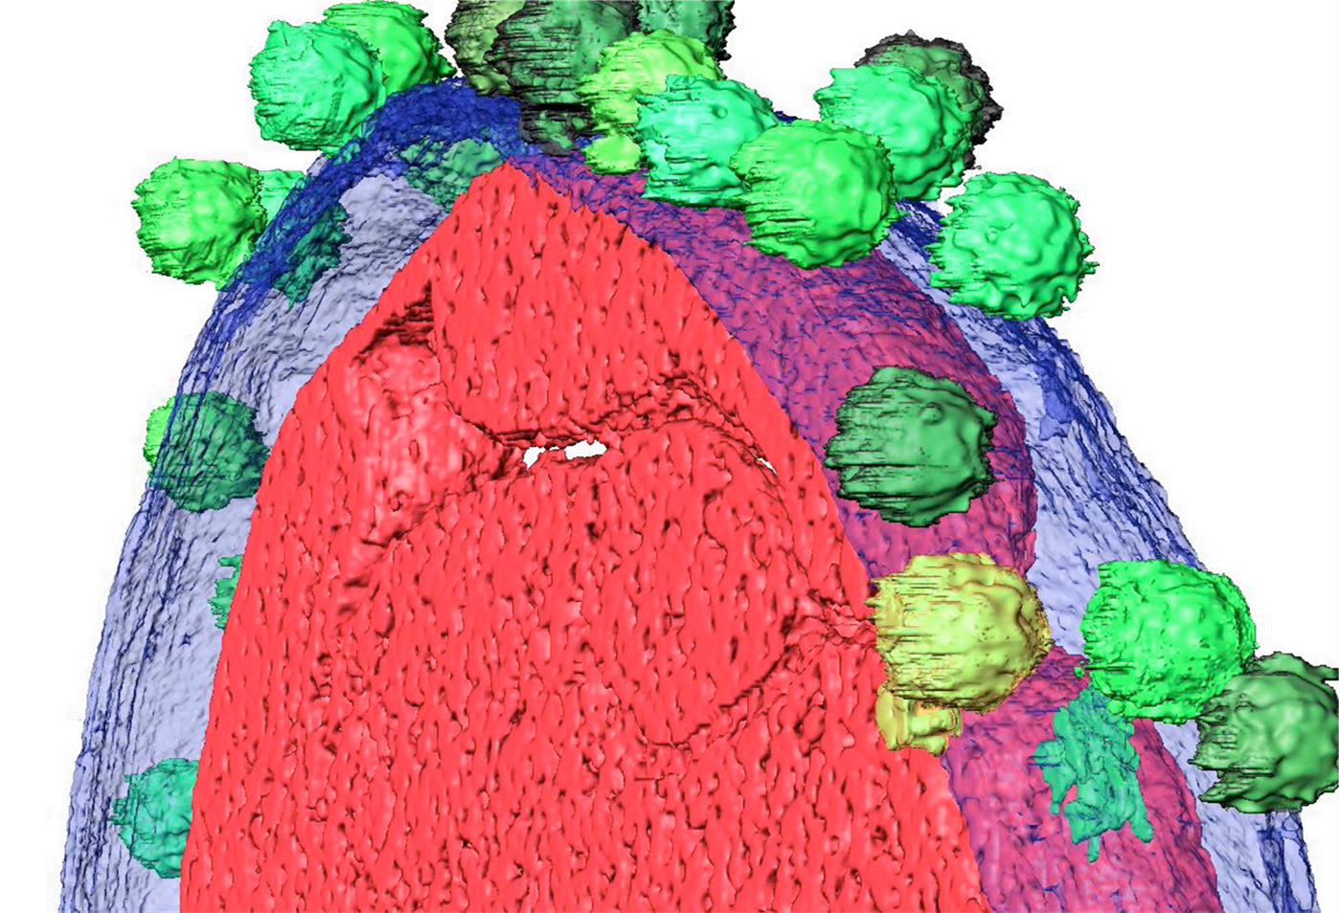
Images
25-80Å resolution electron tomography
8k x 8k x 1k images soon (256 GB)
Notes:
Electron tomography

Slide 54

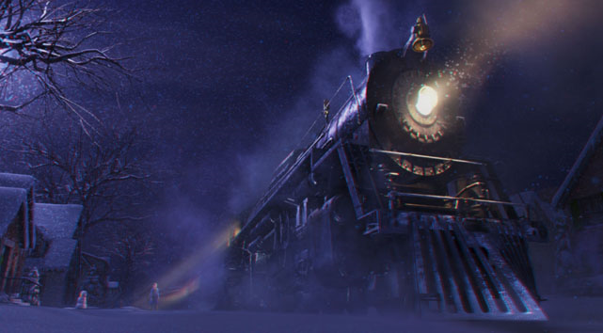
Making movies
Spiderman 3
The Polar Express
Notes:
HDF5 used in making Lord of The Rings
Sony Imageworks. Field3D uses HDF5 for managing enormous amounts of data in CGI.
All the animated files over the past 8 years.

Slide 55
End of part 1

